Slide 1

Basic Details of the Team and Problem Statement
Ministry/Organization Name/Student Innovation: Ministry of Railways
PS Code: SIH1348 Problem Statement Title: “Natural language translation engine for
announcements and information dissemination at stations”
Team Name: Prominence Team Leader Name: Uttam Makwana
Institute Code (AISHE): C-309 Institute Name: Government Engineering College, Gandhinagar
Theme Name: Smart Automation

Slide 2
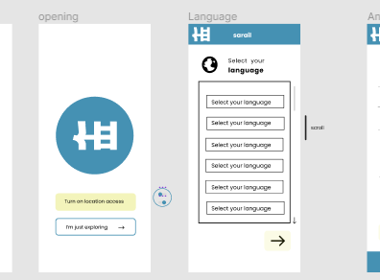
Idea/Approach Details
Describe your idea/Solution/Prototype here:
Translation Engine
Announcements & Information
User Interfaces
Multilingual Support
Chat Bot & Voice Tech
Documentation
Mobile Optimization
Describe your Technology stack here:
React JS
Python
Express
MongoDB
Node
Socket.io

Slide 3
Idea/Approach Details
Describe your Use Cases here
Describe your Dependencies / Show stopper here
Foreigners uses for translation
Local people use for announcement
Indian use for multilingual translation
Intuitive UI
Noisy environment of railway station
Train or Station information dissemination
Ease of access
Super user friendly easy to use
Attractive colors
Gestalt principles followed
SOLID principles

Slide 4
Team Member Details
Team Leader Name: Makwana Uttam Bharatbhai
Branch (Btech/Mtech/PhD etc): BE Stream (ECE, CSE etc): IT Year (I,II,III,IV): IV
Team Member 1 Name: Chaturvedi Aaditya Nilesh
Branch (Btech/Mtech/PhD etc): BE Stream (ECE, CSE etc): IT Year (I,II,III,IV): IV
Team Member 2 Name: Prajapati Palak Rajeshsinh
Branch (Btech/Mtech/PhD etc): BE Stream (ECE, CSE etc): BM Year (I,II,III,IV): III
Team Member 3 Name: Tank Gunjan Dineshbhai
Branch (Btech/Mtech/PhD etc): BE Stream (ECE, CSE etc): CE Year (I,II,III,IV): III
Team Member 4 Name: Ambaliya Manan Jayeshbhai
Branch (Btech/Mtech/PhD etc): BE Stream (ECE, CSE etc): CE Year (I,II,III,IV): IV
Team Member 5 Name: Trivedi Madhav Kamleshbhai
Branch (Btech/Mtech/PhD etc): BE Stream (ECE, CSE etc): CE Year (I,II,III,IV): IV
Team Mentor 1 Name: Pinal Patel
Category (Academic/Industry): Academic Expertise (AI/ML/Blockchain etc): Software Development Domain Experience (in years): 5

